Slide 1
getchar ; putchar ; scanf ; printf

Slide 2
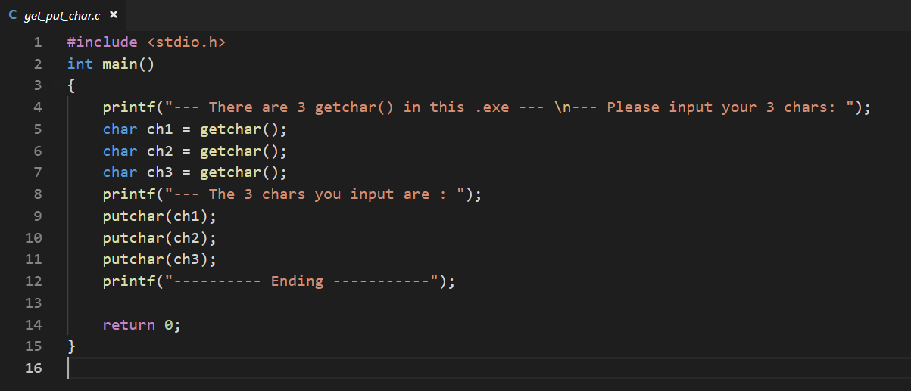
Testing: 123 or 12 or 1

Slide 3
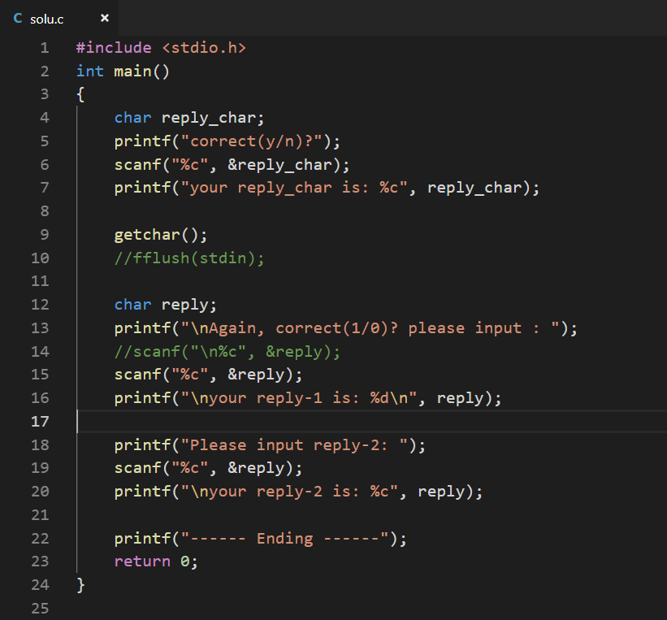
Testing:
1234 or 123

